Slide 1
Automotive safety systems
Review 2

Slide 2
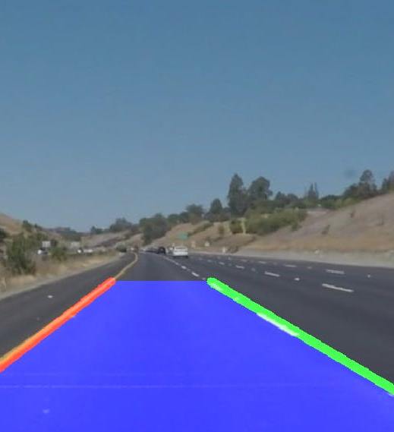
PROJECT TITLE
Lane Detection

Slide 3
TEAM MEMBERS
AARSHA MITHRA VAVILALA -19BMA0035
YANDRA MURALI – 19BMA0003
MEET BHANUSHALI – 19BMA0061

Slide 4
Abstract
Identifying lanes on the road is a common task performed by all human drivers to ensure their vehicles are within lane constraints when driving, so as to make sure traffic is smooth and minimize chances of collisions with other cars in nearby lanes. Similarly, it is a critical task for an autonomous vehicle to perform. Autonomous Vehicles are using Commuter vision based systems for this as a part of Localization and being used in autonomous vehicles starting from Level 1(Based on 5 levels of Autonomy).In this project we will be using Computer Vision techniques to perform the same.

Slide 5
objectives
To detect lanes on roads using a monocular camera in several ODD.
To find the central offset of the vehicle

Slide 6
APPLICATIONS
DRIVER ASSISTANCE
LANE DEPARTURE WARNING
LANE KEEPING SYSTEMS

Slide 7
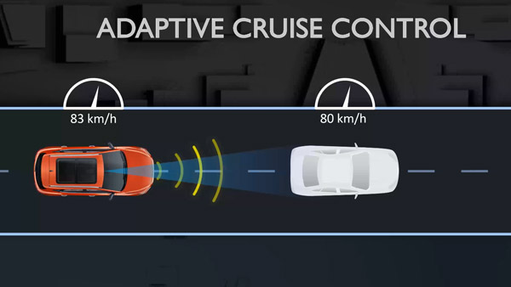
ADAPTIVE CRUISE CONTROL (acc)
ACC uses Lane Keeping in addition to several other sensors.

Slide 8
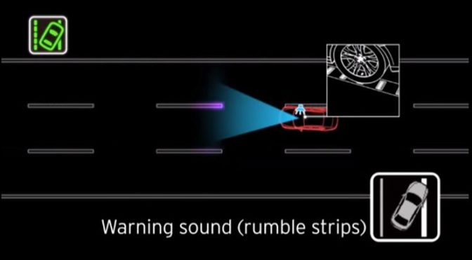
Lane departure crashes
Lane departure crashes occur when a vehicle drifts out of its lane and either runs off the road to the right or moves into the path of oncoming traffic to the left. While lane departure accidents are usually attributed to driver error, there are a number of reasons why a car might drift. Lane detection system keeps traqck on the lane marks and helps minimize these accidents.

Slide 9
PROCEDURE
Isolate Pixels That Could Represent Lane Lines
The first part of the lane detection process is to apply thresholding to each video frame so that we can eliminate things that make it difficult to detect lane lines. By applying thresholding, we can isolate the pixels that represent lane lines.

Slide 10
procedure
Thresholding Steps
1. Convert the video frame from BGR (blue, green, red) color space to HLS (hue, saturation, lightness).
The HLS color space is better than the BGR color space for detecting image issues due to lighting, such as shadows, glare from the sun, headlights, etc. We want to eliminate all these things to make it easier to detect lane lines. For this reason, we use the HLS color space, which divides all colors into hue, saturation, and lightness values.
2. Perform Sobel edge detection on the L (lightness) channel of the image to detect sharp discontinuities in the pixel intensities along the x and y axis of the video frame.
Sharp changes in intensity from one pixel to a neighboring pixel means that an edge is likely present. We want to detect the strongest edges in the image so that we can isolate potential lane line edges.

Slide 11
procedure
3. Perform binary thresholding on the S (saturation) channel of the video frame.
A high saturation value means the hue color is pure. We expect lane lines to be nice, pure colors, such as solid white and solid yellow. Both solid white and solid yellow, have high saturation channel values.
Binary thresholding generates an image that is full of 0s (black) and 255 (white) intensity values. Pixels with high saturation values (e.g. > 80 on a scale from 0 to 255) will be set to white, while everything else will be set to black.
4. Perform binary thresholding on the R (red) channel of the original BGR video frame.
This step helps extract the yellow and white color values, which are the typical colors of lane lines.
Remember, pure white is bgr(255, 255, 255). Pure yellow is bgr(0, 255, 255). Both have high red channel values.
To generate our binary image at this stage, pixels that have rich red channel values (e.g. > 120 on a scale from 0 to 255) will be set to white. All other pixels will be set to black.

Slide 12
procedure
5. Perform the bitwise and operation to reduce noise in the image caused by shadows and variations in the road color.
Lane lines should be pure in color and have high red channel values. The bitwise AND operation reduces noise and blacks-out any pixels that don’t appear to be nice, pure, solid colors (like white or yellow lane lines.)

Slide 13
PROCEDURE
Apply Perspective Transformation to Get a Bird’s Eye View
from the perspective of the camera mounted on a car below, the lane lines make a trapezoid-like shape. We can’t properly calculate the radius of curvature of the lane because, from the camera’s perspective, the lane width appears to decrease the farther away you get from the car.
Imagine you’re a bird. You’re flying high above the road lanes below. From a birds-eye view, the lines on either side of the lane look like they are parallel.
For the first step of perspective transformation, we need to identify a region of interest (ROI). This step helps remove parts of the image we’re not interested in. We are only interested in the lane segment that is immediately in front of the car.

Slide 14
procedure
Identify Lane Line Pixels
Set Sliding Windows for White Pixel Detection.
Fill in the Lane Line.
Overlay Lane Lines on Original Image.
Calculate Lane Line Curvature.
Calculate the Center Offset.
Display Final Image.
Detect Lane Lines in a Video.
Troubleshooting.

Slide 15
Expected progress per review
Review 1-Lane detection in a still image
Review 2-Lane detection in a Video
Review 3-Optimization of code and Report.

Slide 16
Progress
Applied the methods stated earlier to detect lanes in a still image

Slide 17
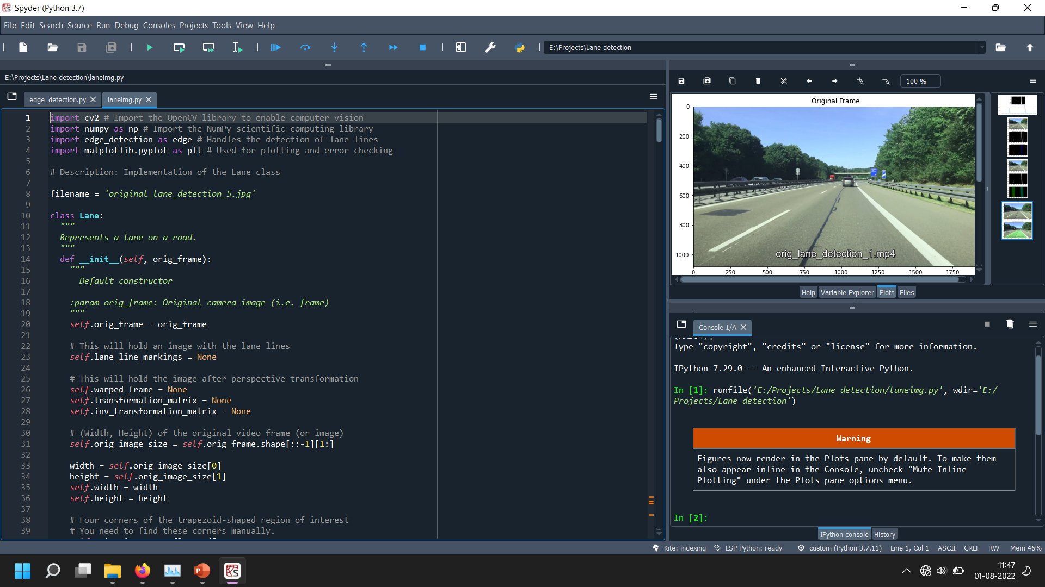

Slide 18
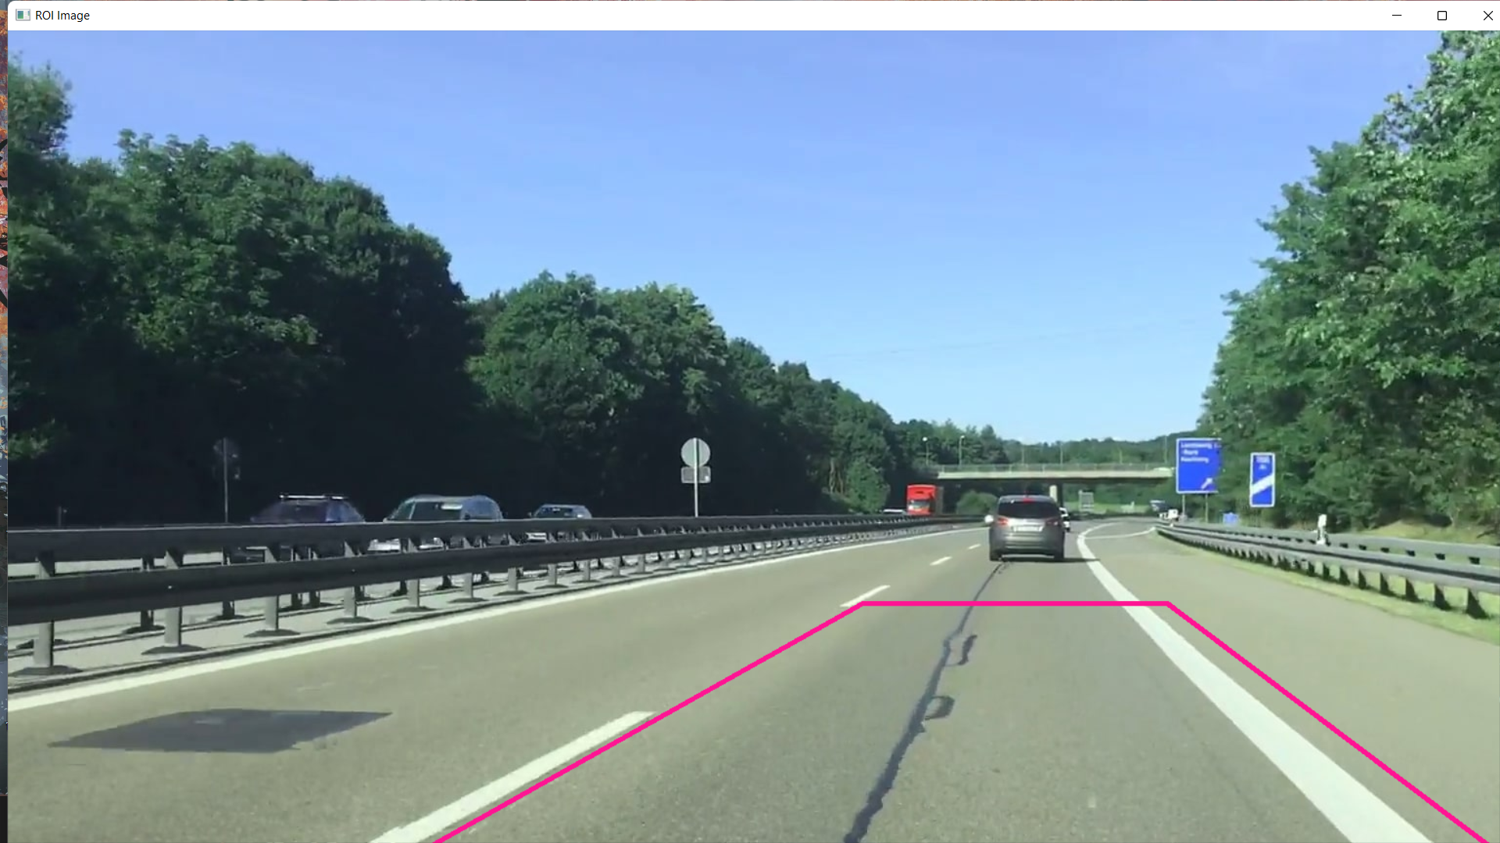
ROI in a IMAGE

Slide 19
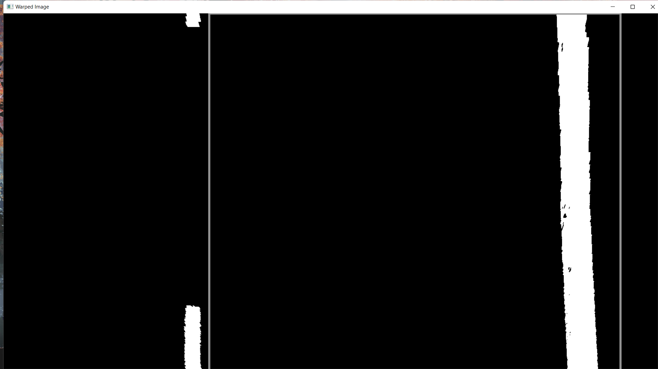
Warped ROI

Slide 20
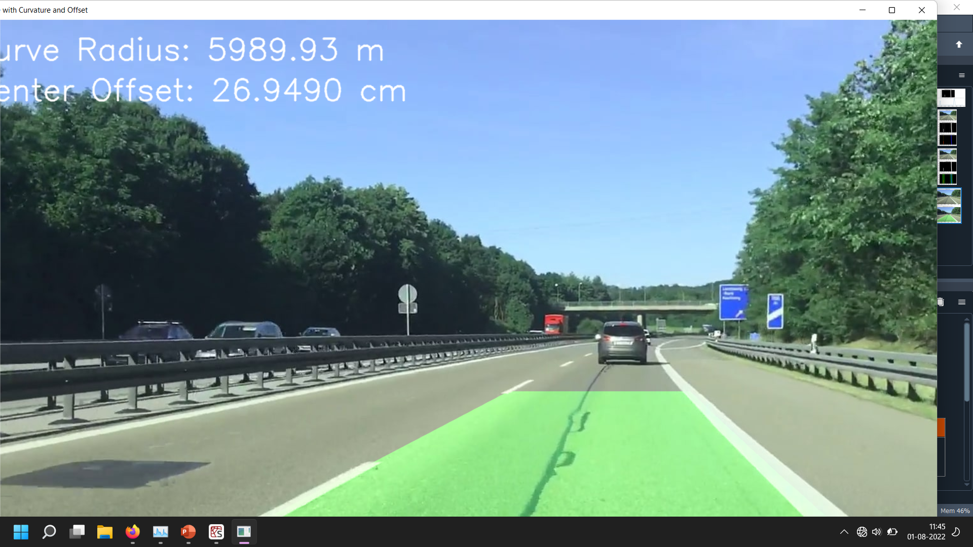
Lane and central offset

Slide 21
THANK YOU!

